Slide 1
Network basics- home network design
Name: Fatema
Intended Major: Information Technology
Purpose: University Scholarship Preparation
Date: 18/ jan /2026

Slide 2
Introduction
Computer networks are a essential part of information technology, connecting devices and sharing information. This project introduces preliminary networking concepts and provides an explanation of a simple home network. The purpose of this project is to build a solid base in networking and prepare me for future academic studies in IT.
Computer network, internet and modem:
Computer network: a communication system that connects multiple devices and smaller networks together using unified protocols to share data.
Internet: a decentralized global network that connects computers, phones, and other devices for communication and information exchange.
Modem: device connecting the home network to the (ISP) converts digital signals from a computer to signals suitable for transmission over the ISP's network.

Slide 3
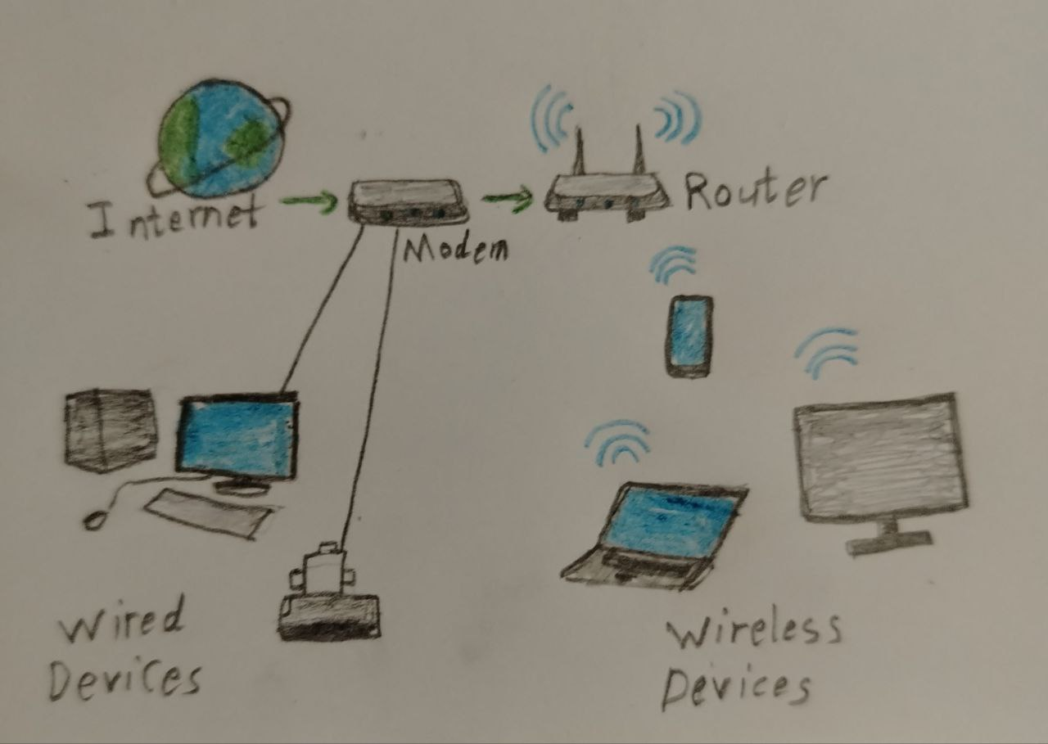
Router and devices
Router: Distributes internet to multiple devices and provides basic firewall protection, it offers wireless Wi-Fi and sometimes wired ethernet ports.
End Devices: Laptop, Smartphone, Tablet. Each device needs an IP address to identify itself on the network
Cables – If the network is wired: An Ethernet cable connects devices to the router. offers higher speed and security compared to Wi-Fi.

Slide 4
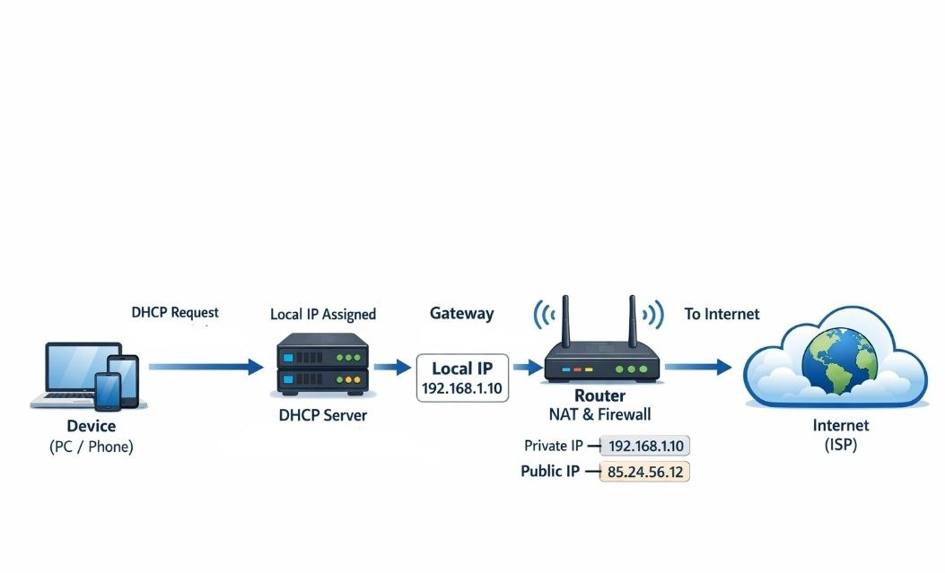
IP Address, DNS & DHCP
IP Address: A unique number assigned to each device on the network.
DNS: Translates domain names (website names) into IP addresses.
DHCP: Automatically assigns IP addresses to devices when they connect to the network.
The command (ifconfig) shows the IP address of the device on a Mac
Example: 192.168.1.10

Slide 5
Internet security
Internet security: the security made to protect the system while connected to the internet
common internet security problem:
1. Malware: combines the words "malicious" and "software", a risky software that cyber criminals use to steal private data. like worms, viruses and trojans
2. Phishing: is a cyberattack that uses phony emails. Hackers send links to the victim or require private data
3. Botnets: A botnet is a network of computers that have been secretly controlled by a cyber criminal.
4. Spam: a large quantities of unwanted mail. often contain malware.
5. Data loss: It is the loss of data via various means. for example a thief can steal it or a hacker can damage a server or hard drive containing sensitive or important information.

Slide 6
Ways to enhance security
Multi-factor authentication (MFA): to use multiple types of identification to certify the justification of someone trying to log in to a system.
Browser selection: to use a browser with high adept to protect.URL filtering
URL filtering: a kind of web filtering, restrict access to harmful websites, sites with offensive or illegal content.
Data loss prevention: strategies designed to prevent sensitive data from being lost by insecure cloud storage.
Firewalls: sieve the incoming and outgoing of the network.
FfDf

Slide 7
Conclusion
This project provided a clear understanding of the fundamental concepts of computer networks, I learned how the Internet connects to a modem, how a router distributes connectivity to devices and how IP addressing, DNS and DHCP enable communication between devices and the Internet and Digital security threats and how to avoid them. This project strengthened my interest in Information Technology and prepared me for future academic studies by building a strong foundation in networking concepts essential for IT-related university programs.

